Slide 1

Library Management System
Modern Library Management Made Simple
Java-Based Solution for Academic Libraries
Developed by: Chandra Prakash GitHub : Library System

Slide 2

System Architecture
A three-tier architecture designed for scalability, security, and efficient library operations across student and librarian workflows.
Core Technologies: Java| Java FX | SQL Database | Object-Oriented Design
Database Layer
SQL storage, transactions, and persistence services
Book Management
Cataloging, circulation, reservations, and APIs
User Management
Students & Librarians access and workflows

Slide 3

Key Features
📚 Book Management
👥 User Management
Add and remove books from inventory
Separate student and librarian accounts
Real-time stock updates
Secure password authentication
Track issue and return status
Automated fine calculation
Role-based access control
Complete user profile management

Slide 4
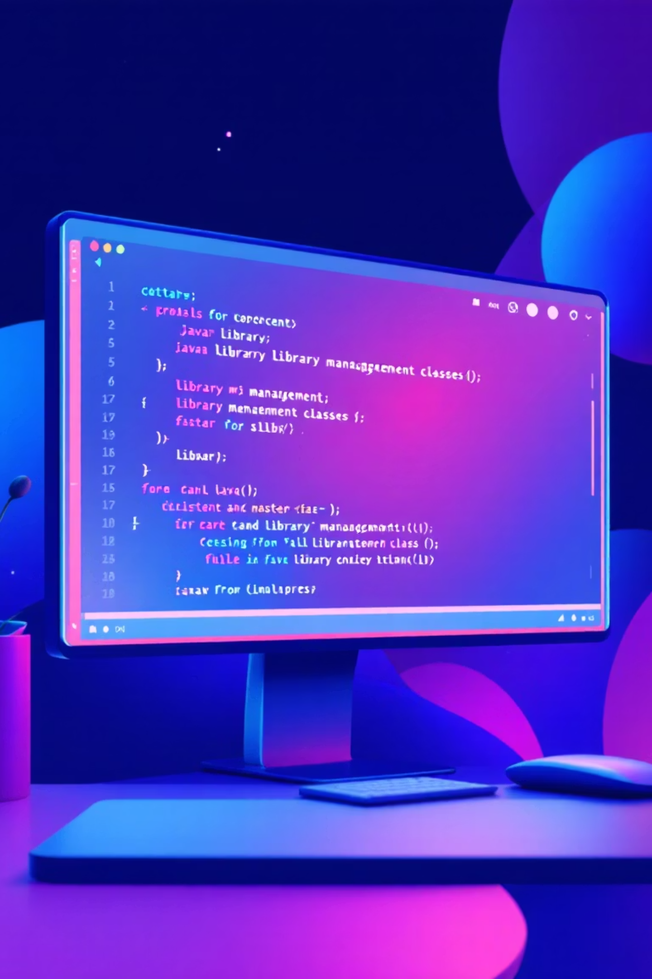
Technical Implementation
The system follows object-oriented principles with a modular structure for maintainability and extensibility.
Core Components
1
Book.java | Student.java | Librarian.java | Library.java
Data Persistence
2
DatabaseManager.java handles all SQL operations securely
Business Logic
3
Enforces 7-day issue period and ₹10/day fine system

Slide 5

System Workflow & Benefits
Streamlined processes ensure efficient library operations with complete transparency and real-time updates.
01
02
03
Book Issue
Return Management
Fine Settlement
Students request books; system validates availability and logs the transaction
System records return date and calculates applicable fines if overdue
Automated fine calculation at ₹10 per day over 7-day issue period
⚡ Automated Operations
📊 Real-Time Updates
🔐 Secure Access
Eliminates manual tracking errors
Instant visibility into inventory
Role-based permissions protect data

Slide 6

Thank You
NotChandraPrakash/library-management-system
Simplifying library operations through technology

